Slide 1

CSE- 102
Introduction to CS and
Programming Methodology Lab
Lab : 10 Nested Loop, Pattern
Fahad Ahmed
Lecturer, Dept. of CSE
E-mail: fahadahmed@uap-bd.edu

Slide 2
Lab Schedule
Lab-Final
17-Oct-2020 - 3.00 PM- until end

Slide 3
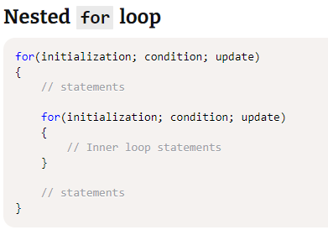
Nested loops in C programming

Slide 4
Nested loops-01
square star pattern
Enter number of rows: 4
****
****
****
****

Slide 5
Nested loops-02
Number pattern with 1, 0 at alternate rows
Enter number of rows: 5
Enter number of columns: 4
1111
0000
1111
0000
1111

Slide 6
Nested loops-03
number pattern with 1, 0 at alternate columns
Enter number of rows: 5
Enter number of columns: 4
0101
0101
0101
0101
0101

Slide 7
Nested loops-04
Right triangle star pattern
Enter value of n: 5
*
**
***
****
*****

Slide 8
Nested loops-05
Mirrored right triangle star pattern
Enter value of n: 5
*
**
***
****
*****

Slide 9
Nested loops-06
Reverse right triangle star pattern
Enter value of n: 5
*****
****
***
**
*

Slide 10
Nested loops-07
C program to print all prime numbers between n to m
Input
Input lower limit: 1
Input upper limit: 20
Output
Prime numbers between 1-20: 2, 3, 5, 7, 13, 17, 19

Slide 11
Practice link
Star patterns
https://codeforwin.org/2015/07/star-patterns-program-in-c.html
Number pattern
https://codeforwin.org/2016/06/number-pattern-programs-in-c.html

Slide 12

Thanks to All

